Slide 1
Future States Processing DRAFT Collaborative Intelligence Projector-Aspect Overview (V0.1)
Chris Argenta
Applied Research Associates, Inc.
ARA and LAS customer Proprietary
Shared with IBM under NDA

Slide 2
FSP API Overview and Terminology
A “Misson” is an instance of the FSP system to capture knowledge about a domain and potential future states.
A mission has a start time (could be prior to now), and an “Horizon” which is the most future time we want to project out to
A “State-Space” for a mission is a tree structure representing states over time and conditions that interconnect them (and do branching) such that future states are conditioned on previous states and potential conditioning factors/events.
The state-space of the mission can be viewed in multiple ways
Raw – a likely really big tree of states and conditions
Aggregated – a processed and more focused view of the state-space
Queried – An aggregated view with summary reporting (supporting narrative)

Slide 3
Knowledge Representation Overview
Cond. Events
Mission
Composed
Of
May
Include
Many
Cond. Options
May Specify
States
Connects
Edges
May
Include
Many
Are
Instances
Of
Unique
Values
For
Entities
Entity Types
Specifies
May
Include
Many
FeatureSlots
Requires
Value
For
Features
Named by
Feature Maps
Are
Instances
Of
Feature Types
Specifies

Slide 4
CI Projector Overview and Terminology
Collaborative Intelligence is a subsystem within FSP
The CI Projector a component that operates as a “standard projector”
Is mapped to specific Features of Entities for a Mission
Reads Feature values from State
Creates new States (and interconnections) with updated Feature values
Requires additional information (decoration) on FeatureType
Human-readable phases – used when forming questions for crowd
An identified method for Feature Aggregation – used for combining answers
Time frame of projection is flexible
Time frame for executing a projection is longer
Other components operate over multiple States and Conditions
Not addressed in this briefing

Slide 5
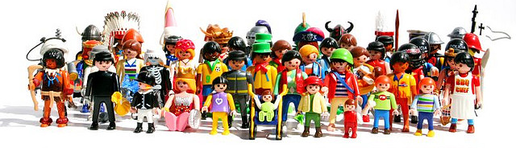
CI Projector Overview
Mission
Assigns
Parameters
For Input / Output
Crowd Sourcing
Projectors
Features
Data Types,
Units, etc..
Submit
Question(s)
Is Called
For Existing
CI Projector Question Processing
Get
Answers
Conditional
Information
State
New State(s)
Estimates Features
For Future State
And Links New State
New Edge(s)
States from multiple projectors
can then be aggregated.
With
Conditioning Events

Slide 6
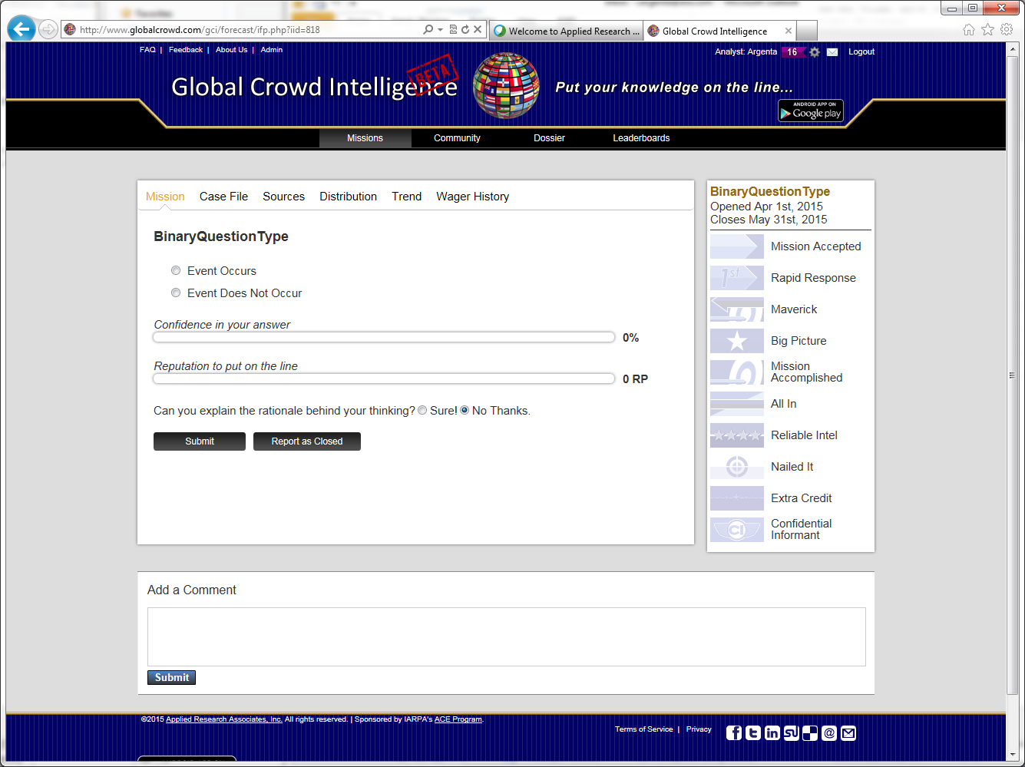
Using the CI as a Projector
Horizon (for current projection) = 2016
If Exxon produced 100 million barrels of oil in the 2015 timeframe
How many million barrels of oil will Exxon produce in 2016?
Million
Confidence in your answer
Date 2015
…
Exxon
Barrels/Year 100
Cost / Barrel 100
…
110
This takes time!
FeaturesType
User | Weight | Value | Confidence
1 | .5 | 100 | .78
2 | .6 | 120 | .80
3 | .7 | 110 | .67
4 | .4 | 115 | .70
5 | .3 | 90 | .90
6 | .2 | 210 | .52
FeatureAggregator
112 (c .81)

Slide 7
CI Projector Creates Next State with Projected Value
Horizon (for current projection) = 2016
Date 2015
…
Exxon
Barrels/Year 100
Cost / Barrel 100
…
Date 2016
…
Exxon
Barrels/Year 112
Cost / Barrel 100
…
States from multiple projectors (or different questions)
can then be aggregated.

Slide 8
So What if the Crowd Doesn’t Converge?
Assuming Exxon’s oil produced was 100 million barrels in the 2015 timeframe
Some people believe Exxon’s oil production of oil would be 200 million barrels in the 2016 timeframe.
Others believe Exxon’s oil production would be 60 million barrels in the 2016 times
Which of the following might cause Exxon’s oil production of oil to be 200 barrels in 2016?
OPEC changes limits (raises)
New oil wells (discovered)
Other:
Confidence in your answer…
60
200
Attempt to discover a conditioning event that explains the discrepancy.
Seed options with previously given and highest ranked
answers

Slide 9
CI Projector Creates Next State with Projected Value
Horizon (for current projection) = 2016
Date 2015
…
Exxon
Barrels/Year 100
Cost / Barrel 100
…
Date 2016
…
Exxon
Barrels/Year 200
Cost / Barrel 100
…
OPEC changes limits
Raises
Date 2016
…
Exxon
Barrels/Year 60
Cost / Barrel 100
…
Lowers

